Slide 1
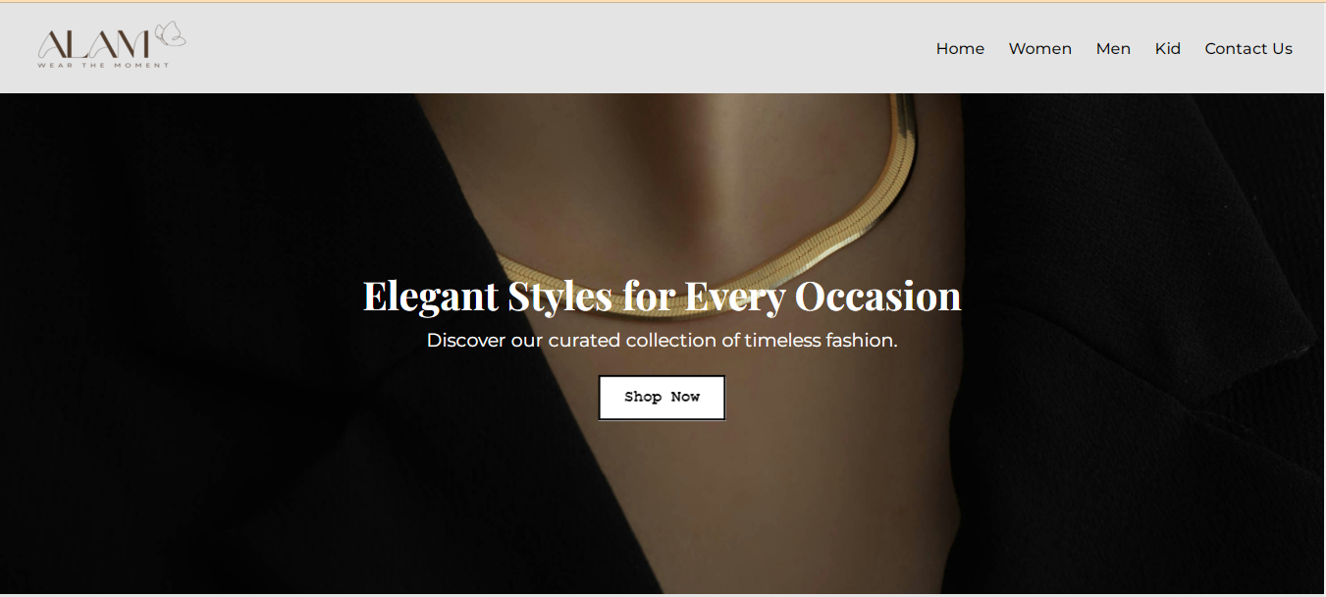
E-commerce website for online store
1

Slide 2

Project Team:
Group Leader:
ArizaIqbal
Team Members:
Laiba Jamil
Armeen Azam
Manahil Abbas
2

Slide 3
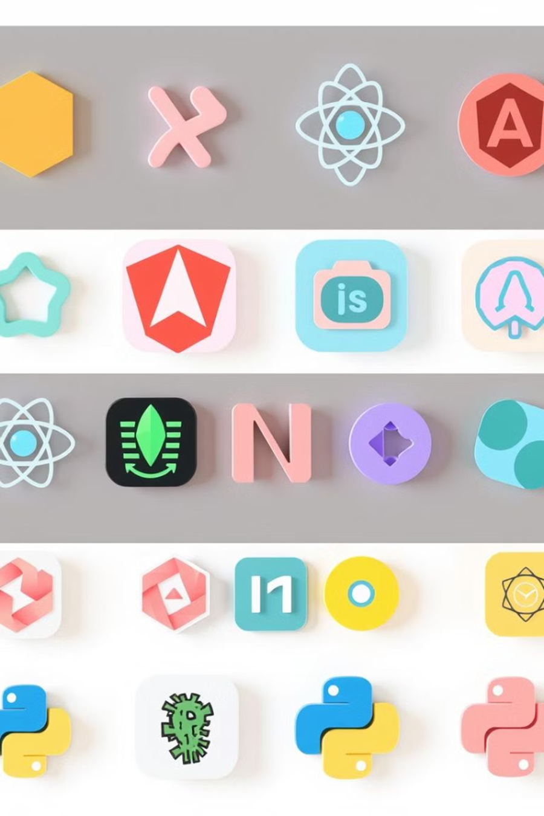


Technology Stack:
HTML
CSS
Structured markup for the website's content and layout
Styling and visual presentation of the website.
3

Slide 4
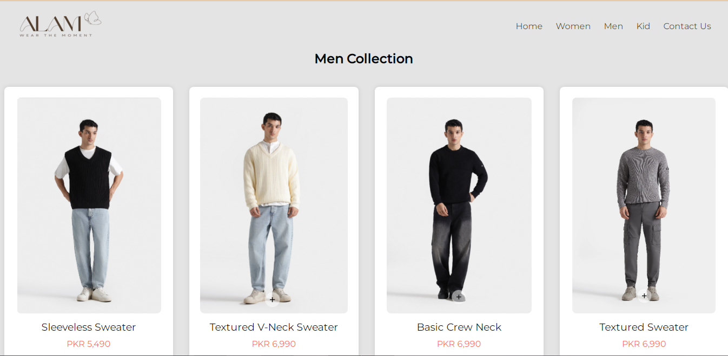
TABLE OF CONTENTS
01
Men’s Corner:
Browse the latest styles for him, from casual tees to tailored suits.
4

Slide 5
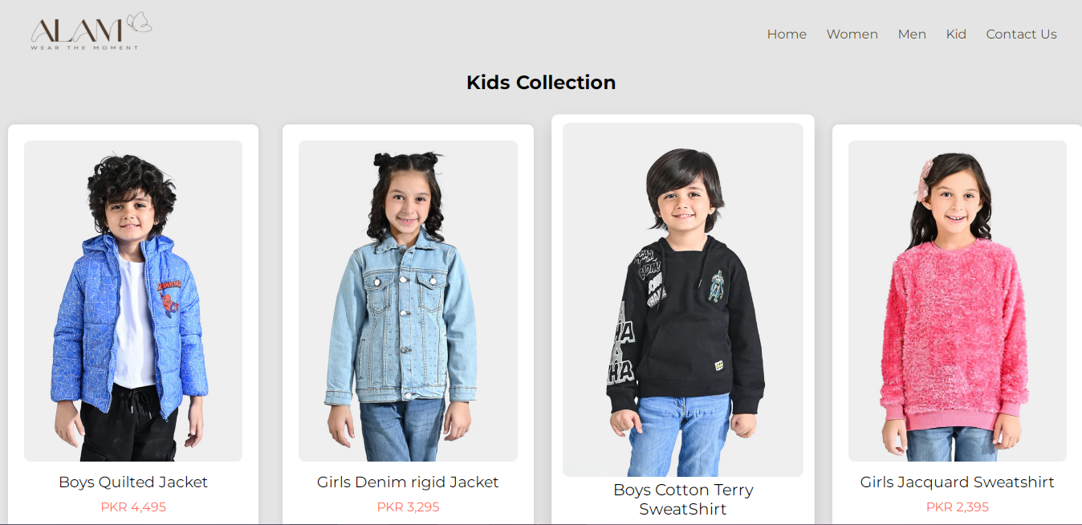
Kid’s Collection:
02
Outfit the whole family with our adorable children's line
5

Slide 6
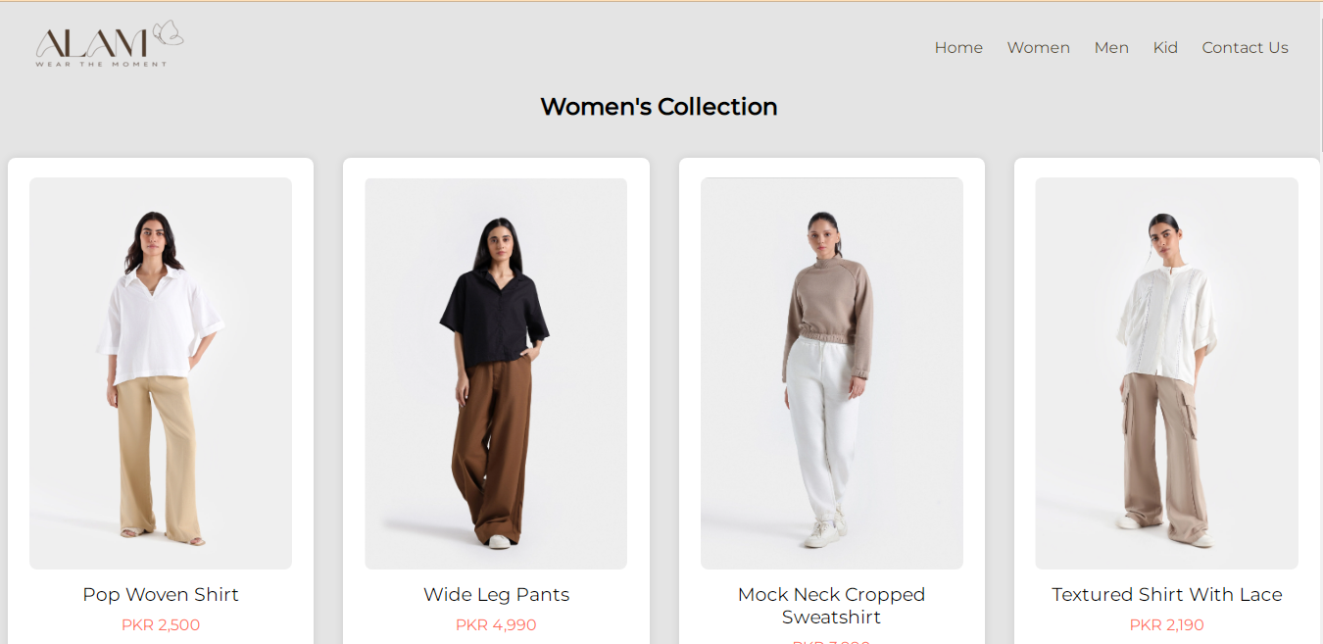
Women’s Boutique:
03
Discover on-trend fashions that flatter every figure
6

Slide 7
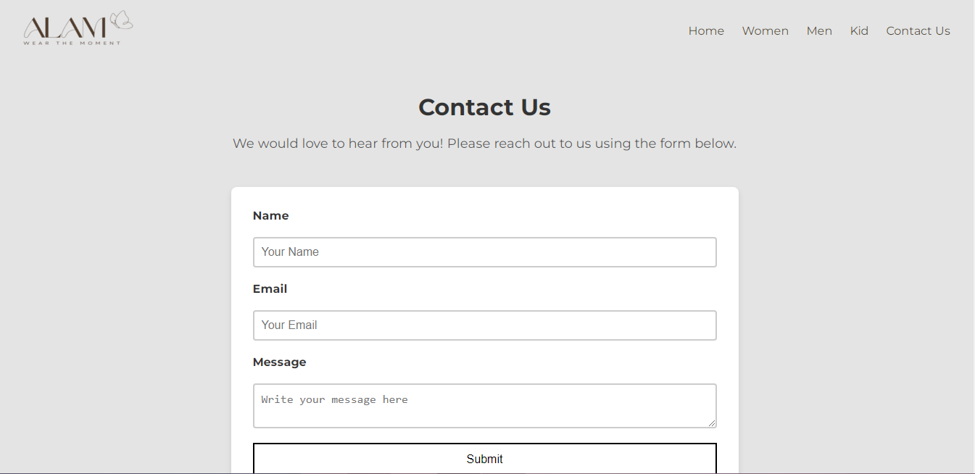
04
Contact Us Section:
Customers will easily communicate with us through the contact us page.
7

Slide 8
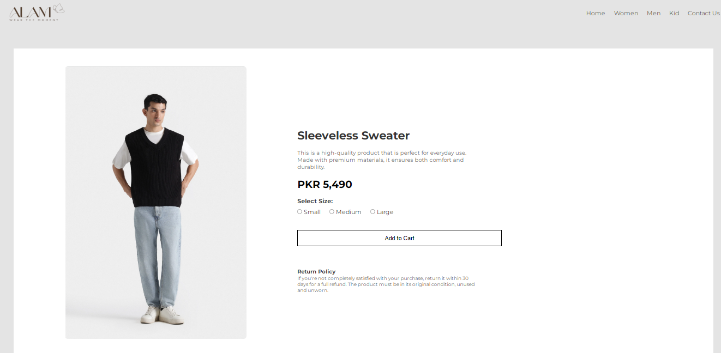
Men Product ::
Also when click on specific product it opens as a separate product with different size and add to cart option in all three sections men women and kid.
8

Slide 9
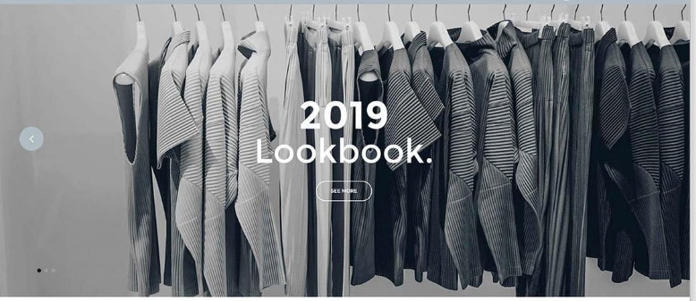
From Where we got the idea?
We got the idea for this project by observing the growing popularity of online shopping and identifying the challenges faced by the customers, So we decided to focus on a clothing store that organizes products by gender and size.
Additionally our interest in fashion and the opportunity to apply our web development knowledge HTML and CSS motivated us to create a user-friendly platform tailored to customer needs.
9

Slide 10
References:
1.Project Development Environment:
Our project was developed using Visual Studio Code (VS Code), leveraging its powerful features, including an integrated terminal, extensive library of extensions, and seamless version control through GitHub. The choice of VS Code enhanced our productivity, provided a robust development environment, and streamlined the collaboration process throughout the project's lifecycle.
.
2.Google Fonts
Google Fonts is a free library of web-optimized fonts that helps E-commerce websites improve their design and readability. By integrating custom fonts, you can enhance the user experience and give your site a distinctive look
3. W3Schools:
A beginner-friendly platform providing step-by-step tutorials and interactive examples for HTML and CSS. Ideal for quick learning and referencing specific topics.
10

Slide 11

Conclusion :
Seamless Shopping Experience:
The e-commerce website will provide customers with a streamlined and enjoyable shopping experience, catering to their clothing preferences and size requirements.
Increased I Customer Satisfaction:
By offering a wide range of clothing options, secure transactions, and responsive design, the website aims to enhance customer satisfaction and loyalty.
11

